Slide 1
ARITHMETIC APTITUDE
Û
Æ
þ
Ø
WELCOME ALL
SHABANA

Slide 2

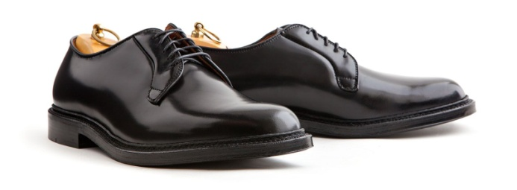

MONEY
Mayor Brogan was a man of great honesty. The other day he went to his
favourite Haberdashery store and said to the man in the hat department, “I
want that $10.00 hat in the window. If you lend me as much as I have in my
pocket I’ll buy it”. The sales man said ok and gave him the
money. The mayor then paid cash for the
hat. Next he went to the suit department
and bought a $10.00 jacket
using the same proposition. On the way out he stopped in the
Shoe department and bought a $10.00 pair of shoes, paying
in the same way. When he left the store, he had no money
in his pockets. How much money did Brogan have when he first entered the
store?

Slide 3
Introduction / Arithmetic Aptitude - I | Divisibility , Co Prime Factor pairs, Short cuts to find Squares, cubes, square roots, cube roots - 2 digit & 3 digit numbers
Arithmetic Aptitude - I | Divisibility , Co Prime Factor pairs, Short cuts to find Squares, cubes, square roots, cube roots - 2 digit & 3 digit numbers
Arithmetic Aptitude - II | Remainder Concepts, Progression, Last digit, Last two digits, Surds, Indices, Algebra
Ratios, Averages and Ages | Bridging components, Standard & Variable data, Removal & Replacement in Averages, Application on ages
Commercial Math | Percentage expressions, Percentage change, Net percentage change, Profit, Loss, Discounts, Mark ups
Partnership & Alligations | Investments, Shares, Withdrawals, Alligation rule and its applications in other concepts
Analytical & Inductive Reasoning | Comparing, different verticals of data
Data Arrangement | Blood relations - 4 types, Seating arrangement - Facing in / out, Combining datas
Time & Distance | Componendo & Dividendo concepts, Distance / Time reference, Trains, Boats & Streams, Races
Time & Work | Chain rule, And / Or Concept, Efficiency, Comparisons, Pipes & Cisterns
Worksheet | Time and Distance & Time & Work
Cubes, Cuboids & Dices | Standard & General Dices, Cubes, Painted and Blocked cubes, Painted cuboids, Cubes - numbered
Spatial Aptitude & Transformation of shapes | Figure series, Tricks to find the number of triangles, Flowcharts
Probability | Basic Definitions & Concepts, Theorems of Probability and their applications, Expected value
Permutations & Combinations | Fundamental principle of counting, And - Or Simplification, Together and never concepts, at least and at most approach to solve problems
Venn diagrams | General approch to different set of datas
Syllogisms | Basic diagrams, connectives, Conclusions with No and Conclusions with Possibility
Mensuration | Triangles, Quadrilaterals, Regular polygons, Circles, Rectangular solids, Prisms and Spheres
Geometry | Lines & Angles, Parallel lines, Triangle Properties, Heights & Distances
Coding Decoding, Crypt Arithmetic | Number matching, different symbols, Matrix matching, Number based crypt arithmetic problems
Series, Analogies & Number puzzles | Missing numbers, letters and number based and series and analogies, symbols and notations
Data Interpretation | Table chart, Bar graphs, Line chart, Pie charts and combination of them
Data Sufficiency | Based on analytical ability, coding, blood relations, ranking and seating
Puzzles, Miscellaneous problems | Linear equations with 1 and 2 variables, Quatratic equations and equations of a higher degree, Logarithm, Inequalities, Input/Output Machines, Clocks, Calendars, Simple Interest, Compound Interest

Slide 4
EVALUATION PATTERN
MID EXAM – I – 25%
MID EXAM – II – 25%
END SEM EXAM – 50%

Slide 5

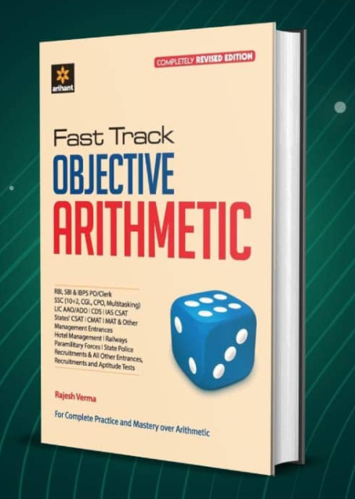
REFERNCE BOOKS
QUANTITATIVE APTITUDE FOR CAT - ARUN SHARMA
FAST TRACK OBJECTIVE ARITHMETIC, ARIHANT PUBLICATIONS

Slide 6
TOPICS
DIGITAL ROOTS
SHORTCUTS – SQUARES OF 2 & 3 DIGIT NUMBER
SHORTCUTS – CUBES OF 2 & 3 DIGIT NUMBER
SHORTCUTS – SQUARE ROOT & CUBE ROOTS OF PERFECT SQUARE NUMBERS
CO PRIME FACTOR PAIRS
TIPS TO FIND IF THE GIVEN NUMBER IS PRIME
DIVISIBILITY RULES

Slide 7
DIGITAL ROOT
Find the digital root of 58762301
Digital root of any perfect square will fall among 1, 4, 7, 9 only
Not any prime number except 3 will have 3, 6 or 9 as its digital root

Slide 8
SIMPLIFY
1777 – 2349 – 1345 + 6523
4706
4606
4976
4176
5016 x 1001 – 333 x 77 + 22 = ? X 11
435570
454127
527240
366531

Slide 9
SIMPLIFY
2387 – 123 + 980 = ? – 145 + 945
2244
2355
2434
2444
135% of 342 – 342% of 15.3
411.13
412.23
414.43
415.53

Slide 10
SQUARES OF 2 DIGIT NUMBER
ENDING WITH ZERO
ENDING WITH 5
ENDING WITH ANY OTHER DIGIT
1

Slide 11
SQUARES OF 3 DIGIT NUMBER
LESS THAN 316 / GREATER THAN 317
TYPE A – Rounding off to less than nearest 50
TYPE B – Rounding off beyond 50
2

Slide 12
CUBES OF 2 DIGIT NUMBER
ENDING WITH ZERO
STARTING WITH 1
ENDING WITH 1
DOUBLETS
ENDING WITH ANY OTHER DIGIT
2

Slide 13
CUBE OF 3 DIGIT NUMBER
(102)³
(103)³
2
(110)³

Slide 14
SQUARE ROOT
1521 =
1² = 1
2² = 4
3² = 9
4² = 16
5² = 25
6² = 36
7² = 49
8² = 64
9² = 81
10² = 100
2209
6724
8649
2

Slide 15
CUBE ROOT
19683 =
157464 =
912673 =
1³ = 1
2³ = 8
3³ = 27
4³ = 64
5³ = 125
6³ = 216
7³ = 343
8³ = 512
9³ = 729
10³ = 1000
2

Slide 16
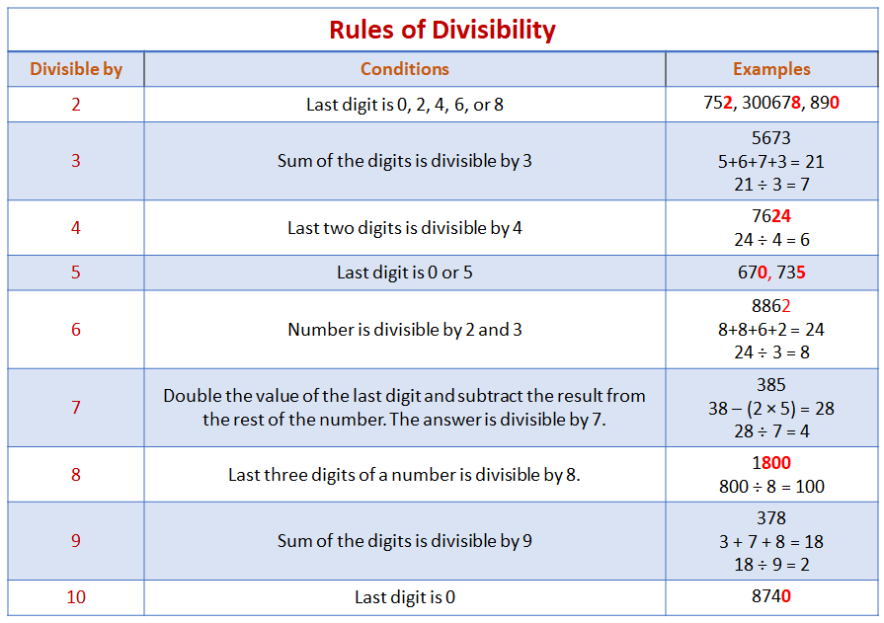
DIVISIBILITY RULES

Slide 17
IMPORTANT FORMULAS & STRATEGIES - NUMBERS
Sum of first n natural numbers = n(n+1)/2
Sum of the squares of first n natural numbers = n(n+1)(2n+1)/6
Sum of the cubes of first n natural numbers = [n²(n + 1)²] / 4
Sum of first n natural odd numbers = n²
Arithmetic Progression
t_{n} = a + (n – 1)d
S_{n} = n[2a + (n – 1)d] / 2
where ‘a’ is the first term, ‘d’ is the common difference, t_{n} is the nth term and S_{n} is the sum of n terms.
Geometric Progression
tn = a r^{(n-1)}
Sn = a(r^{n} – 1) / r – 1 , when r>1
Sn = a(1 - r^{n} ) / 1 - r , when r<1
Sn = nxa, when r = 1
where ‘a’ is the first term, ‘d’ is the common ratio, tn is the nth term and Sn is the sum of n terms.

Slide 18
HCF & LCM – RAPID INFORMATION LIST
S.No | Type of Problem | Approach to Problem
1 | Find the greatest number that will exactly divide x, y and z. | Required number = HCF of x, y and z
2 | Find the greatest number that will divide x, y and z leaving remainders a, b and c respectively | Required number = HCF of (x – a), (y – b) and (z – c)
3 | Find the least number that is exactly divisible by x, y and z. | Required number = LCM of x, y and z
4 | Find the least number which when divided by x, y and z leaves remainder a, b and c respectively. | Then it is observed that x – a = y – b = z – c = k Required number = (LCM of x, y, z) – k
5 | Find the least number which when divided by x, y and z leaves the same remainder ‘r’ | Required number = (LCM of x, y, z) + r
6 | Find the greatest number that will divide x, y and z leaving same remainder in each case | Required number = HCF of (x - y), (y – z) and (z – x)

Slide 19
HCF & LCM OF FRACTIONS
HCF OF NUMERATORS
HCF OF FRACTIONS =
LCM OF DENOMINATORS
LCM OF NUMERATORS
LCM OF FRACTIONS =
HCF OF DENOMINATORS

Slide 20
FEW REMAINDER CONCEPTS
X^{n} + 1 will always be divisible by X + 1 only when n is odd.
X^{n} – 1 will always be divisible by X + 1 only when n is even.
x^{n} – a^{n} is always divisible by x – a for all values of n.
x^{n} – a^{n} is always divisible by x + a for even values of n.
x^{n} + a^{n} is always divisible by x + a for odd values of n.
x^{n} + a^{n} is not divisible by x – a for any value of n.
For any value of n, if any number (kx + 1)^{n} divided by x will leave a remainder 1^{n}
When p is a prime number and N is any natural number not divisible by p, then N^{p-1} if divided by p will leave a remainder 1.

Slide 21
FACTORS & MULTIPLES
NUMBER | NO.OF FACTORS | NUMBER | NO.OF FACTORS
54400 |  | 557 x 699
54400 x 30600 |  | 1230 x 2870
444 x 888 |  | 3220 x 5290
120 x 240 x 360 |  | (3230)²

Slide 22
FACTORS
To find the number of Factors
Express the number as N = a^{p} x b^{q} x c^{r}
No. of factors = (p+1)(q+1)(r+1)
Sum of the factors = [a^{p+1} – 1 / a – 1 ] [b^{q+1} – 1 / b – 1 ] [ c^{r+1} – 1 / c – 1]
Product of the factors = N^{(p+1)(q+1)(r+1)/2} (Including 1 & N)

Slide 24
TRAILING ZEROES
NUMBER | NO.OF TRALING ZEROES | NUMBER | NO.OF TRALING ZEROES
153! |  | 332! + 400!
188! |  | 325! X 53!
122! |  | 153! + 188!
224! |  | 122! X 224!

Slide 26
LAST DIGIT
NUMBER | LAST DIGIT | NUMBER | LAST DIGIT
(999)⁸⁸⁸ |  | (557)⁶⁹⁹ x (699)⁵⁵⁷
(544)⁶⁸⁸ x (306)⁴⁰⁵ |  | (123)²⁸⁷ x (287)¹²³
(445)⁹⁷⁵ x (888)⁹³² |  | (322)⁵²⁹ x (529)³²²
(122)²⁴⁴ x (244)³⁶⁶ x (366)¹²² |  | (32)²² X (88)⁴⁴ X (66)⁶⁶

Slide 28
LAST TWO DIGITS
NUMBER | LAST TWO DIGITS | NUMBER | LAST TWO DIGIT
(81)³⁹⁹ |  | (125)¹²⁴
(171)⁸⁶⁷ |  | (275)²⁷⁵
(43)¹⁶² |  | (46)²⁵⁰
(119)⁴⁵⁶ |  | (88)¹⁰²

Slide 29
LAST TWO DIGITS
Case – 1 – Ending in 1
Case – 2 – Ending with 3, 7, 9
Case – 3 – Ending with 5
Case - 4 – Ending in even numbers

